Slide 1
Renewable Energy Sources
SOLAR ENERGY

Slide 2
Concept of Renewable Energy
Renewable energy sources also called non-conventional energy are sources that are continuously replenished by natural processes. For example, solar energy, wind energy, bio-energy bio-fuels grown sustain ably), hydropower etc., are some of the examples of renewable energy sources.
A renewable energy system converts the energy found in sunlight, wind, falling-water, sea waves, geothermal heat, or biomass into a form, we can use such as heat or electricity.
Most of the renewable energy comes either directly or indirectly from sun and wind and can never be exhausted, and therefore they are called renewable.

Slide 3
Various forms of renewable energy
Solar energy
Wind energy
Bio energy
Hydro energy
Geothermal energy
Wave and tidal energy

Slide 4
Solar Energy-Basic information
Solar energy is the most readily available and free source of energy since prehistoric times.
It is estimated that solar energy equivalent to over 15,000 times the world's annual commercial energy consumption reaches the earth every year.
India receives solar energy in the region of 5 to 7 kWh/m2 for 300 to 330 days in a year.
This energy is sufficient to set up 20 MW solar power plant per square kilometer land area.
Solar energy can be utilized through two different routes:
solar thermal route
solar electric (solar photovoltaic) routes

Slide 5
Solar thermal route uses the sun's heat to produce hot water or air, cook food, drying materials etc.
Solar photovoltaic uses sun's heat to produce electricity for lighting home and building, running motors, pumps, electric appliances, and lighting.

Slide 6
Solar Thermal Energy Application
In solar thermal route, solar energy can be converted into thermal energy with the help of solar collectors and receivers known as solar thermal devices. The Solar-Thermal devices can be classified into three categories:
Low-Grade Heating Devices - up to the temperature of 100°C.
Medium-Grade Heating Devices -up to the temperature of 100°-300°C
High-Grade Heating Devices -above temperature of 300°C
Low-grade solar thermal devices are used in solar water heaters, air-heaters, solar cookers and solar dryers for domestic and industrial applications

Slide 7
Solar water heaters
Most solar water heating systems have two main parts: a solar collector and a storage tank.
The most common collector is called a flat-plate collector. It consists of a thin, flat, rectangular box with a transparent cover that faces the sun, mounted on the roof of building or home.
Small tubes run through the box and carry the fluid - either water or other fluid, such as an antifreeze solution – to be heated.
The tubes are attached to an absorber plate, which is painted with special coatings to absorb the heat.
The heat builds up in the collector, which is passed to the fluid passing through the tubes.

Slide 8
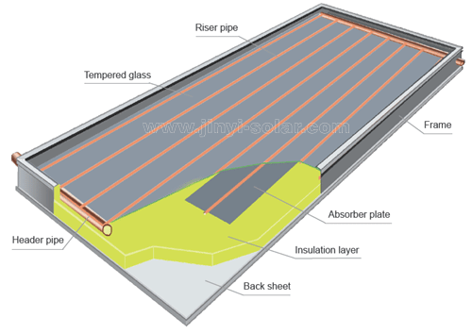
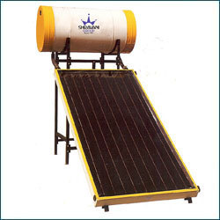
Flate Plate Collector

Slide 9
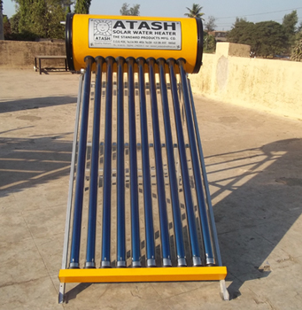
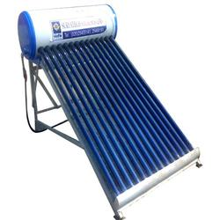
Evacuated Tube Collector

Slide 10
Construction & working
An insulated storage tank holds the hot water. It is similar to water heater, but larger is size.
In case of systems that use fluids, heat is passed from hot fluid to the water stored in the tank through a coil of tubes.
Solar water heating systems can be either active or passive systems. The active system, which are most common, rely on pumps to move the liquid between the collector and the storage tank.
The passive systems rely on gravity and the tendency for water to naturally circulate as it is heated.

Slide 11
Cont…
The solar water heater are also classified as Direct (Open loop) and Indirect (Closed loop) Systems.
Direct or open loop systems circulate potable water through the collectors. They are relatively cheap.
Indirect or closed loop systems use a heat exchanger that separates the potable water from the fluid, known as the "heat-transfer fluid" (HTF), that circulates through the collector.

Slide 12
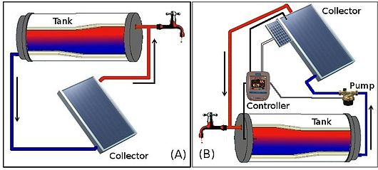
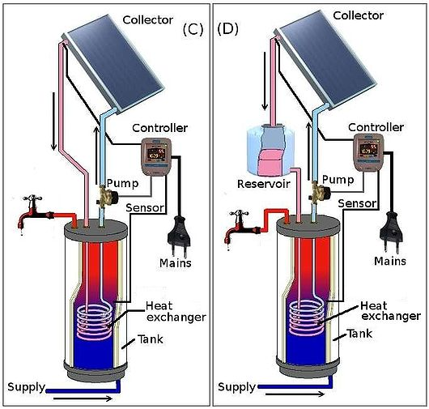
A - Direct passive system
B - Direct Active system
C – Indirect Active System
D – Indirect active system

Slide 13
A few industrial application of solar water heaters are listed below:
Hotels: Bathing, kitchen, washing, laundry applications
Dairies: Ghee (clarified butter) production, cleaning and sterilizing, pasteurization
Textiles: Bleaching, boiling, printing, dyeing, curing, ageing and finishing
Breweries & Distilleries: Bottle washing, wort preparation, boiler feed heating
Chemical /Bulk drugs units: Fermentation of mixes, boiler feed applications
Electroplating/galvanizing units: Heating of plating baths, cleaning, degreasing applications
Pulp and paper industries: Boiler feed applications, soaking of pulp.

Slide 14
Solar Cooker
Solar cooker is a device, which uses solar energy for cooking, and thus saving fossil fuels, fuel wood and electrical energy to a large extent.
However, it can only supplement the cooking fuel, and not replace it totally.
It is a simple cooking unit, ideal for domestic cooking during most of the year except during the monsoon season, cloudy days and winter months.
Box type solar cookers
Parabolic concentrating solar cooker

Slide 15
Box type solar cookers
The box type solar cookers with a single reflecting mirror are the most popular in India.
These cookers have proved immensely popular in rural areas where women spend considerable time for collecting firewood.
A family size solar cooker is sufficient for 4 to 5 members and saves about 3 to 4 cylinders of LPG every year.
The life of this cooker is up to 15 years. This cooker costs around Rs.1000 after allowing for subsidy. Solar cookers are widely available in the market.

Slide 16
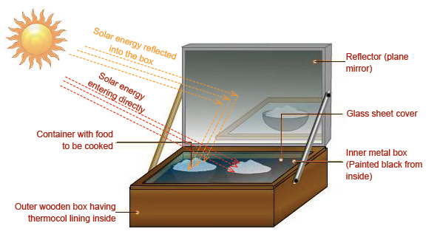
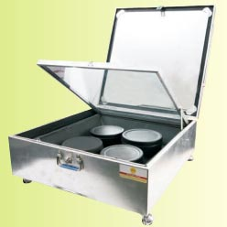
Box type Solar Cooker

Slide 17
Parabolic concentrating solar cooker
A parabolic solar concentrator comprises of sturdy Fiber Reinforced Plastic (FRP) shell lined with Stainless Steel (SS) reflector foil or aluminised polyester film.
It can accommodate a cooking vessel at its focal point. This cooker is designed to direct the solar heat to a secondary reflector inside the kitchen, which focuses the heat to the bottom of a cooking pot.
It is also possible to actually fry, bake and roast food. This system generates 500 kg of steam, which is enough to cook two meals for 500 people (see Figure ). This cooker costs upward of Rs.50, 000.
Positioning of solar panels or collectors can greatly influence the system output, efficiency and payback.

Slide 18
Tilting mechanisms provided to the collectors need to be adjusted according to seasons (summer and winter) to maximize the collector efficiency.
The period four to five hours in late morning and early afternoon (between 9 am to 3pm) is commonly called the "Solar Window".
During this time, 80% of the total collectable energy for the day falls on a solar collector.
Therefore, the collector should be free from shade during this solar window throughout the year - Shading, may arise from buildings or trees to the south of the location.

Slide 19
Solar Electricity Generation Solar Photovoltaic (PV)
Photovoltaic is the technical term for solar electric. Photo means "light" and voltaic means "electric".
PV cells are usually made of silicon, an element that naturally releases electrons when exposed to light.
Amount of electrons released from silicon cells depend upon intensity of light incident on it.
The silicon cell is covered with a grid of metal that directs the electrons to flow in a path to create an electric current.
This current is guided into a wire that is connected to a battery or DC appliance.
Typically, one cell produces about 1.5 watts of power. Individual cells are connected together to form a solar panel or module, capable of producing 3 to 110 Watts power.

Slide 20
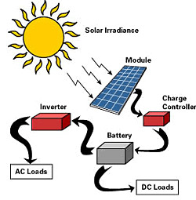
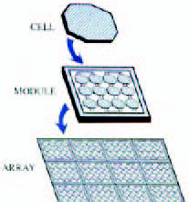
Solar Photovoltaic cell

Slide 21
Panels can be connected together in series and parallel to make a solar array, which can produce any amount of Wattage as space will allow.
Modules are usually designed to supply electricity at 12 Volts. PV modules are rated by their peak Watt output at solar noon on a clear day.
Some applications for PV systems are lighting for commercial buildings, outdoor (street) lighting, rural and village lighting etc.
Solar electric power systems can offer independence from the utility grid and offer protection during extended power failures.
Solar PV systems are found to be economical especially in the hilly and far flung areas where conventional grid power supply will be expensive to reach

Slide 22
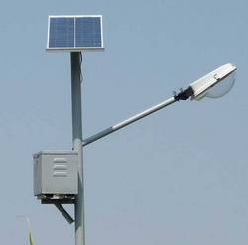
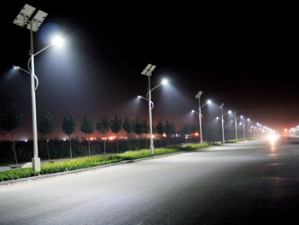
Solar Street light

Slide 23
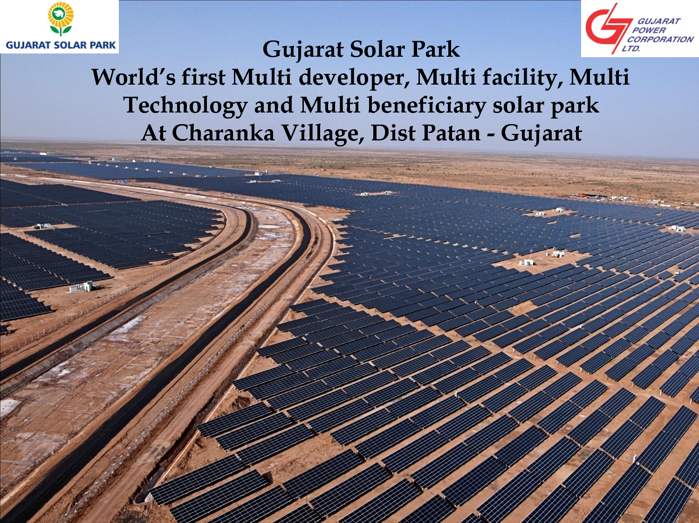
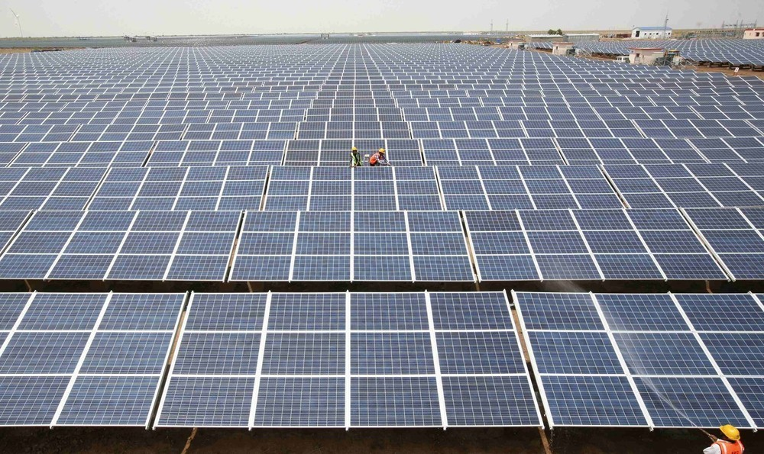
Solar Park (Solar Power plant)

Slide 24
PV tracking systems is an alternative to the fixed, stationary PV panels. PV tracking systems are mounted and provided with tracking mechanisms to follow the sun as it moves through the sky. These tracking systems run entirely on their own power and can increase output by 40%.
Back-up systems are necessary since PV systems only generate electricity when the sun is shining.
The two most common methods of backing up solar electric systems are connecting the system to the utility grid or storing excess electricity in batteries for use at night or on cloudy days.
Performance
The performance of a solar cell is measured in terms of its efficiency at converting sunlight into electricity.
Only sunlight of certain energy will work efficiently to create electricity, and much of it is reflected or absorbed by the material that makes up the cell.
Because of this, a typical commercial solar cell has an efficiency of 15%—only about one-sixth of the sunlight striking the cell generates electricity. Low efficiencies mean that larger arrays are needed and higher investment costs. It should be noted that the first solar cells, built in the 1950s, had efficiencies of less than 4%.

Slide 25
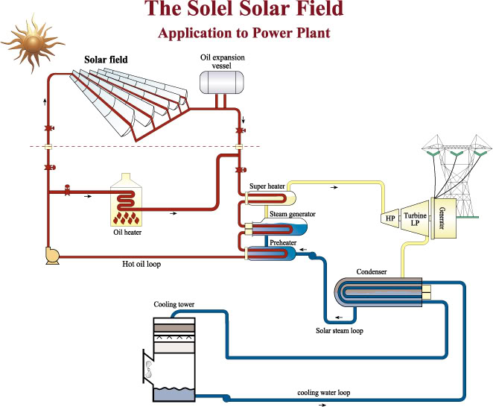
Solar thermal power plant

Slide 26
Solar thermal power plant
There are two main ways of generating energy from the sun. Photovoltaic (PV) and concentrating solar thermal (CST), also known as concentrating solar power (CSP) technologies.
PV is discussed in earlier slides.
Solar thermal technology is large-scale by comparison. One big difference from PV is that solar thermal power plants generate electricity indirectly. Heat from the sun's rays is collected and used to heat a fluid. This fluid is used to heat the water into steam. The steam produced from the heated fluid powers a generator that produces electricity. It's similar to the way fossil fuel-burning power plants work except the steam is produced by the collected heat rather than from the combustion of fossil fuels.

Slide 27
Cont…
The figure in the previous slide shows parabolic collectors which heat the thermal fluid passing at the pipe at the focal point.
This thermal fluid takes the heat and reaches to super heater evaporator and preheater and back to parabolic collector.
At evaporator the feed water converts into wet steam and finally into dry steam in superheater, taking the heat from the thermal fluid.
This high temperature steam works on rankine cycle similar to coal based plants.
A separate oil heater is provided which might be used to heat the oil to required temperature at cloudy or rainy days.

Slide 28
Solar Water Pumps
In solar water pumping system, the pump is driven by motor run by solar electricity instead of conventional electricity drawn from utility grid.
A SPV water pumping system consists of a photovoltaic array mounted on a stand and a motor-pump set compatible with the photovoltaic array.
It converts the solar energy into electricity, which is used for running the motor pump set.
The pumping system draws water from the open well, bore well, stream, pond, canal etc.

Slide 29
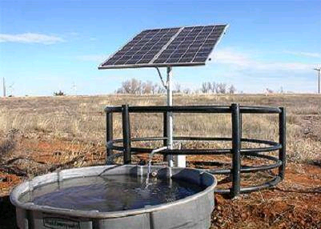
Case example
Under the Solar Photovoltaic Water Pumping Programme of the Ministry of Non-conventional Energy Sources during 2000-01 the Punjab Energy Development Agency (PEDA) has completed installation of 500 solar pumps in Punjab for agricultural uses. Under this project, 1800 watt PV array was coupled with a 2 HP DC motor pump set. The system is capable of delivering about 140,000 litres water every day from a depth of about 6 – 7 metres.

